Slide 1
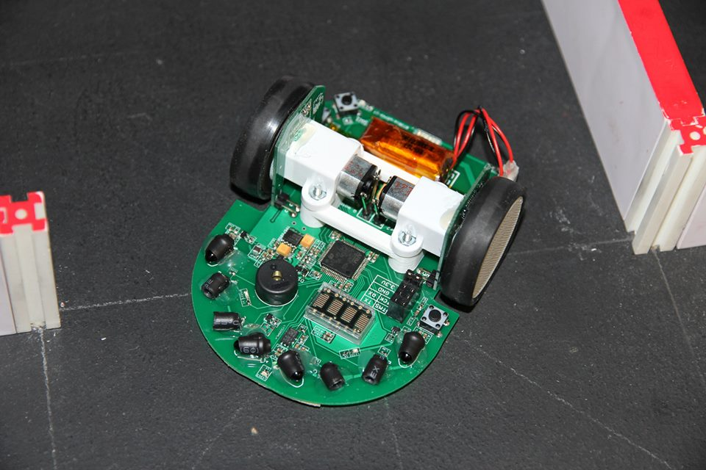
Project Futura

Slide 2
Introduction
To help relatively experienced student to learn advanced knowledge of Micromouse
Kit Mouse that capable to make advance movement, such as curve turn and acceleration were made as teach tools
High resolution encoder is the key.
You can apply the what you’ve learned to a working mouse without struggling with potential hardware problem.
You need to design your own mouse for competition

Slide 3
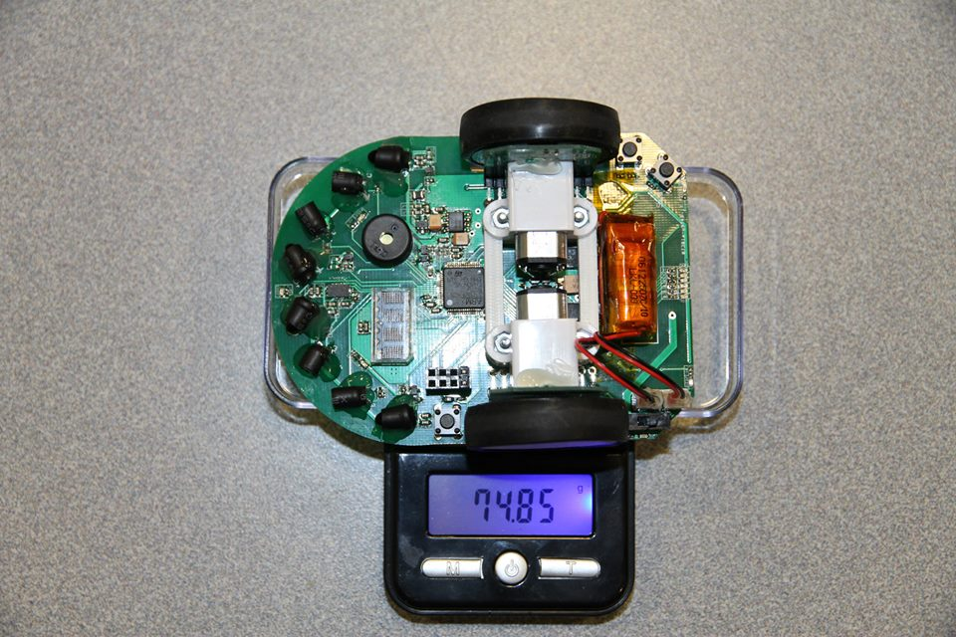
Specs
Width | 75mm
Length | 100mm
height | 38mm
weight | 75g w/ battery
wheel | 3D printed wheel and mount + mini-z tires (MZT302-20)
Processor | STM32F405RGT6(168Mhz with internal RC)
Motor/Encoder | Pololu 1:10 gear motor HP/AS5304 Encoder
Gear ratio | 1:10
battery | 120mah 25C 2s1p
Motor Driver | ZXMHC3F381N8+TC4427 (H-bridge + level shifter)
Sensor | TEFT4300+SFH4545 X 4
Gyro | LY3200
User Interface | 2 buttons + 11 LEDs + dot matrix display

Slide 4
Demo
http://www.youtube.com/watch?v=YJhf3xfEgZY

Slide 5
How it’s made?

Slide 6
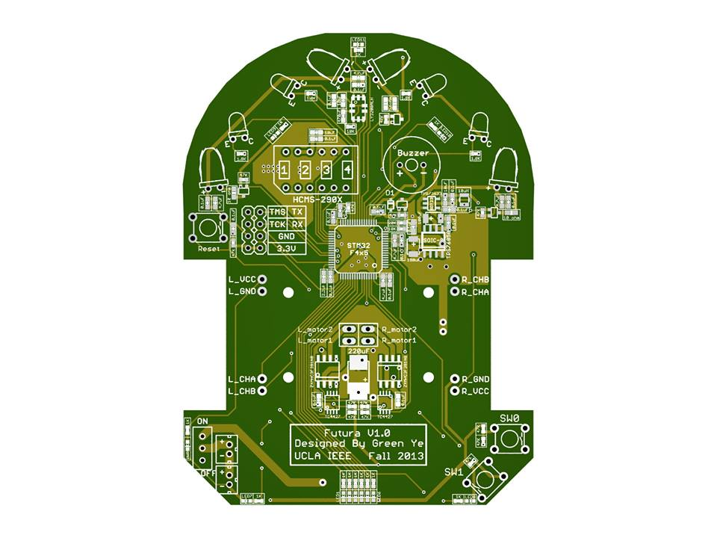
Design PCB

Slide 7
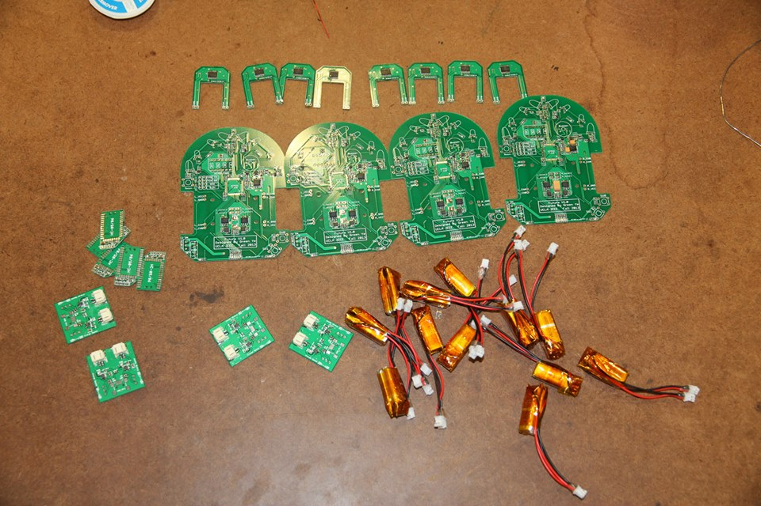
Solder and prepare all parts/components/testing tools

Slide 8
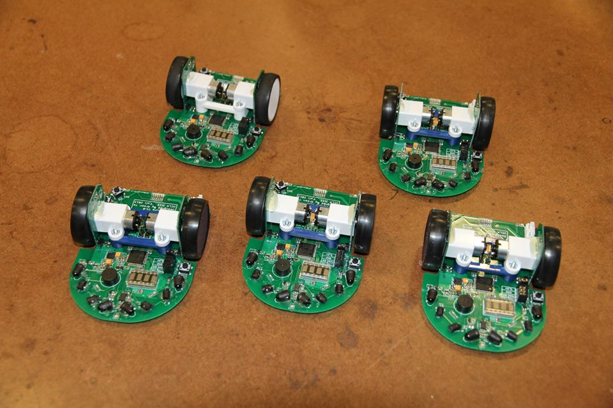
Finish Assembling and do tests to
Make sure everything is working

Slide 9
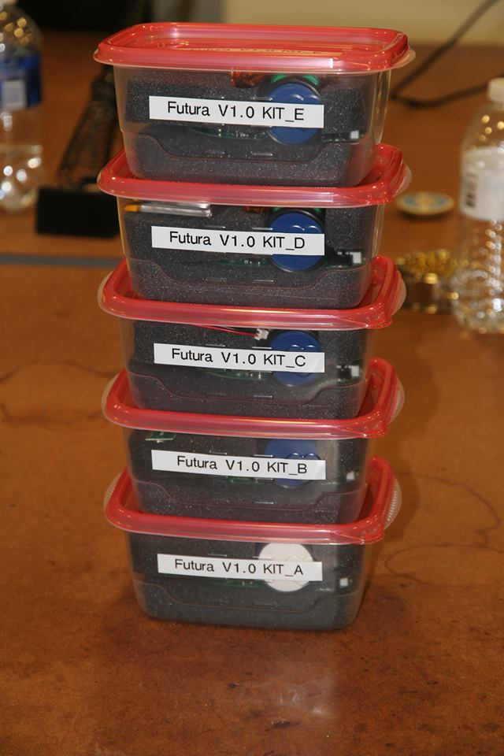
Pack them into containers
Ready to use for future
We spent lots of efforts to make these mouse, play it carefully since they will be used repeatly in the future

Slide 10
Lecture 1

Slide 11
Keil IDE
We will be using the Keil IDE to write our code and program the mouse
Step 1: Install the file mdk460.exe
Step 2: Install the st-link_v2_usbdriver
Step 3: Open the file FuturaProject/project/micromouse_test.uvproj with Keil uVision4

Slide 12
Adding a new file to Keil
Step 1: Create the file in either user_Libraries/src (.c files) or user_Libraries/inc (.h files)
Double click on the group user_Libraries_src or user_Libraries_inc in the “Project” pane and select your file

Slide 13
Downloading your code to the mouse
Connect the three mouse pins, TMS, TCK, and GND, to the ST-link programmer pins, IO, CLK and GND respectively
In Keil uVision, compile your code by pressing F7. Then click Flash->Download.

Slide 14
Sensors
void readSensor()
Reads each sensor and places the results in the global variables: LFSensor, RFSensor, DLSensor, and DRSensor.
This should be called in your systick handler

Slide 15
Gyro
void readGyro()
Similar to readSensor()
Sets the variables aSpeed (your mouse’s angular speed) and angle (the current angle of your mouse

Slide 16
Volt Meter
void readVolMeter()
Sets the variable voltage
Always make sure your batteries are well charged, especially when using the small batteries

Slide 17
Encoders
int32_t getLeftEncCount() & int32_t getRightEncCount()
Returns the current encoder count
3520 encoder counts per revolution

Slide 18
User Interface
Buzzer
void shortBeep(int duration, int freq)
duration – milliseconds
freq – Hz (example 8000)
Matrix display
void displayMatrix(const char* s)
s – 4 character (max) string
See others in matrixDisplay.h
LEDs
LED1_ON, LED2_ON … LED11_ON
LED1_OFF, LED2_OFF … LED11_OFF

Slide 19
Delay
void delay_ms(u32 nTime)
nTime – milliseconds

Slide 20
Interrupts
void systick()
A 1 millisecond timed interrupt
It is a function that runs every millisecond
void button1_interrupt() & void button2_interrupt()
These functions are run when a button is pressed

Slide 21
Motors
void setLeftPwm(int32_t speed) & void setRightPwm(int32_t speed)
speed – A value ranging from -999 through 999, representing the duty cycle of the pwm for the motor.

Slide 22
printf
Used to print debugging information
Example:
printf(“Left front sensor: %d\r\n”, LFSensor);
See more information here: http://www.cplusplus.com/reference/cstdio/printf/

Slide 23
PuTTY
PuTTY is a desktop application that can be used to communicate with the mouse
Download the windows version here: http://the.earth.li/~sgtatham/putty/latest/x86/putty.exe
Set connection type to “Serial”
Under “Serial line” type “COMX” where X is your COM port number
You can find the COM port in Windows Device Manager
In the “Serial” tab, set “Flow control” to “None”
Default options should be fine for everything else

Slide 24
PuTTY
Connect the FTDI board pins TX, RX, and GND to the RX, TX, and GND pins on the mouse
TX connects with RX
RX connects with TX
You can now communicate with your mouse using printf and PuTTY

